Slide 1

Exploratory Analysis of Used Cars, Area-wise Distribution and Brand Analysis.
Team:
Y. Tarun
V. Aneesh
Ch. Ganga Raju

Slide 2
Today Agenda:
Business Problem and Use case domain understanding(If Required)
Objective of the Project
Web Scraping – Details (Websites, Processor you followed)
Exploratory Data Analysis:
a. Data Cleaning Steps
b. Data Manipulation Steps
c. Analysis Steps
Summary of the Data

Slide 3
Objective of the Project :
Problem Statement:
Top 5 Used cars in 5 major cities across India.
The objective of this project is to analyze the distribution of used cars on those cities in India and perform a detailed brand-wise analysis to understand the market trends and preferences of buyers and sellers. The project aims to identify key insights regarding the availability, pricing, and features of used cars in those cities and for different brands.

Slide 4
Used this tools:
Integrated Development Environment(IDE):
1. Jupyter notebook
Programming :
1. Python
Libraries:
1. Pandas
2. Numpy’s
3. Regular Expressions
4. Requests
5. BeautifulSoup
6. Selenium
7. Matplotlip
8. Seaborn

Slide 5
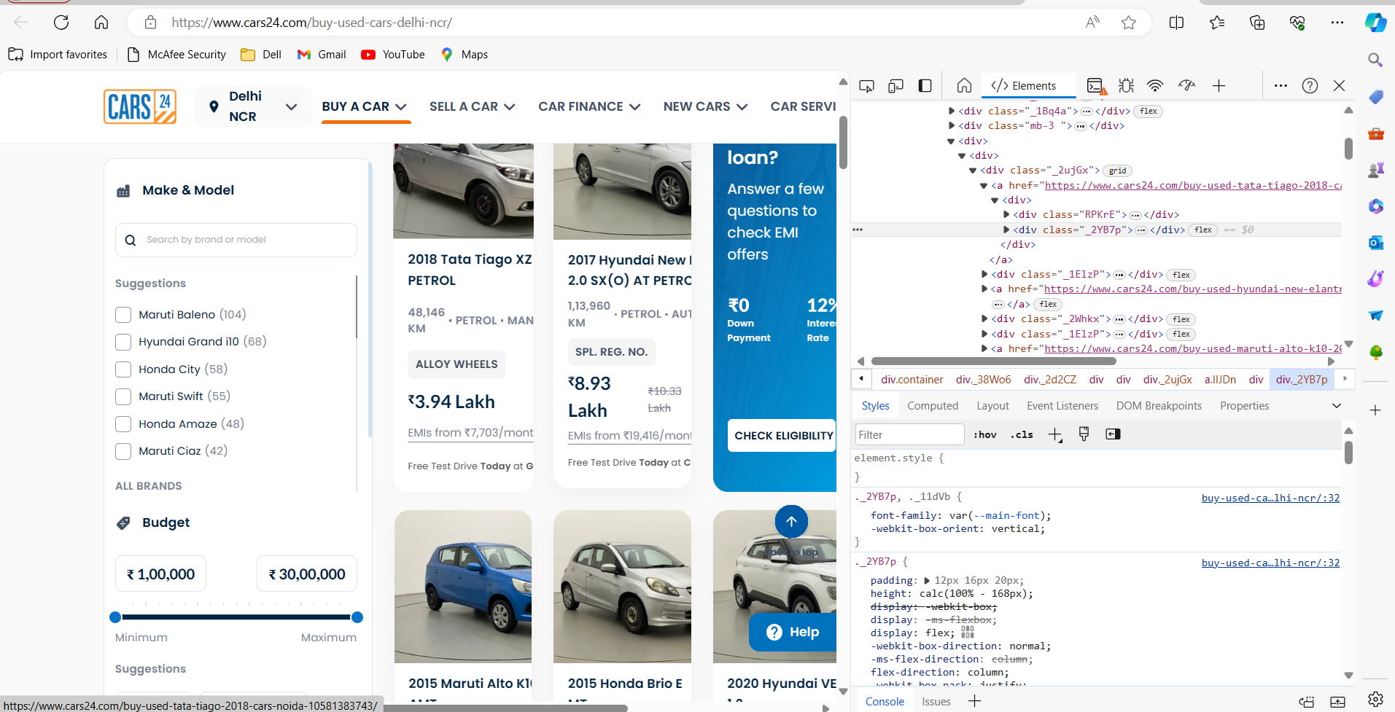
Web Scraping - Details
The web site we used is CARS24.com (https://www.cars24.com/)
Before scraping, I inspected the HTML structure of the target web pages using browser developer tools. This helped identify the specific HTML elements containing the desired data, such as car details (brand, model, year, price, etc.).

Slide 6
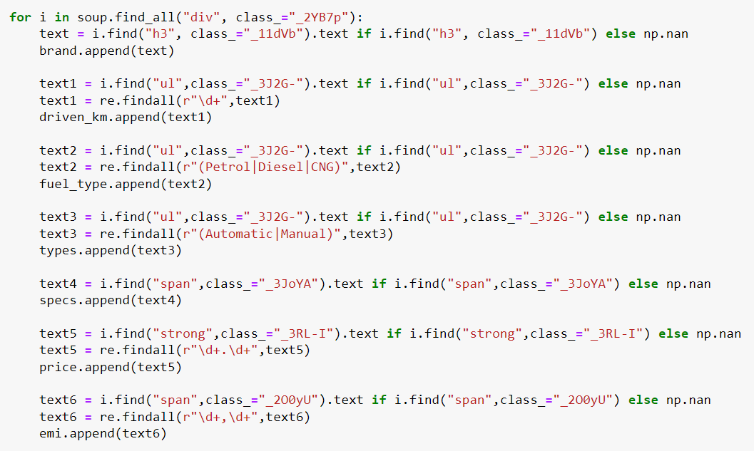

Logic Behind Web Scraping

Slide 7
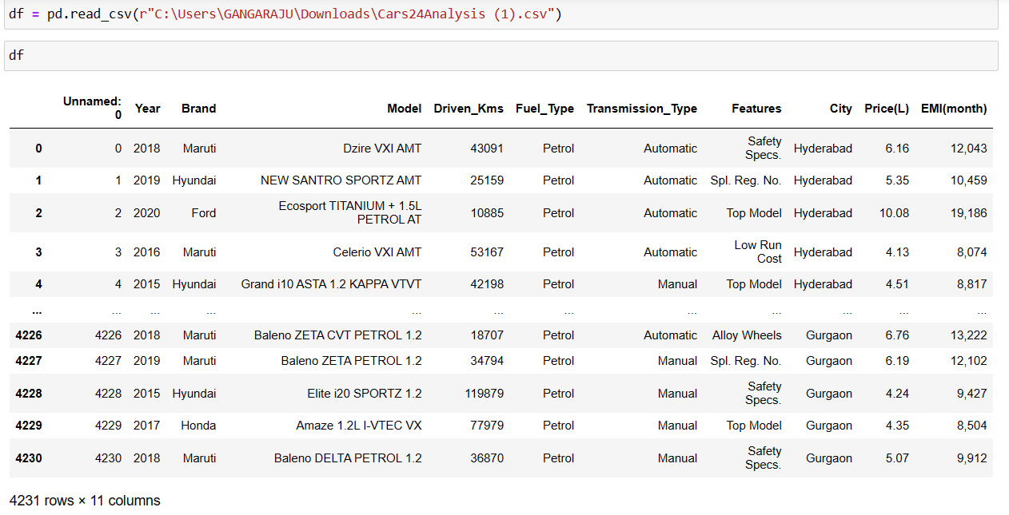
Data Preparation:

Slide 8
Summary of the Data
The dataset contains information on used cars, including attributes such as brand, model, year, price, Emi(month), transmission type, fuel type, and location (area). The dataset is collected from Cars24.com website .It comprises a comprehensive set of records representing the used car market in India.

Slide 9
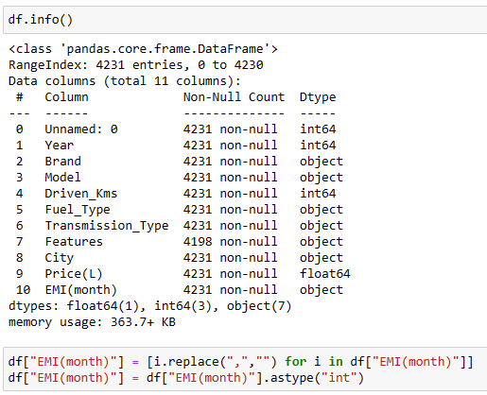

Data Cleaning:
Information:
Actually the “EMI” Column is in object data type we changed the EMI Column object converting into integer type we used astype method

Slide 10
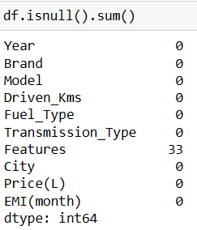
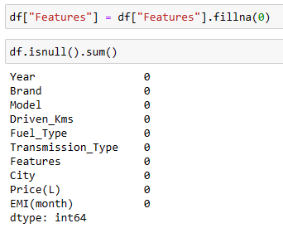
Finding null values in DataFrame:
BEFORE
AFTER

Slide 11
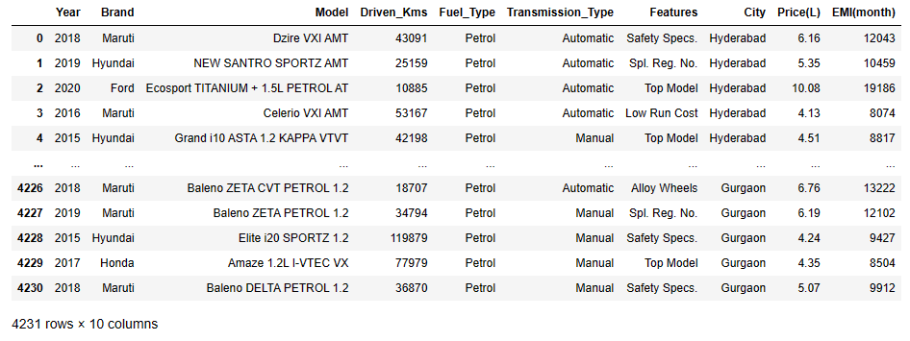
After Cleaning the Data

Slide 12
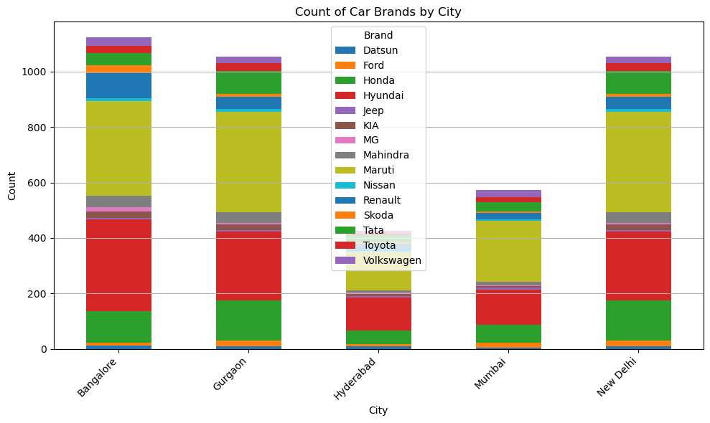
Data Visualization
Car Brands by City

Slide 13
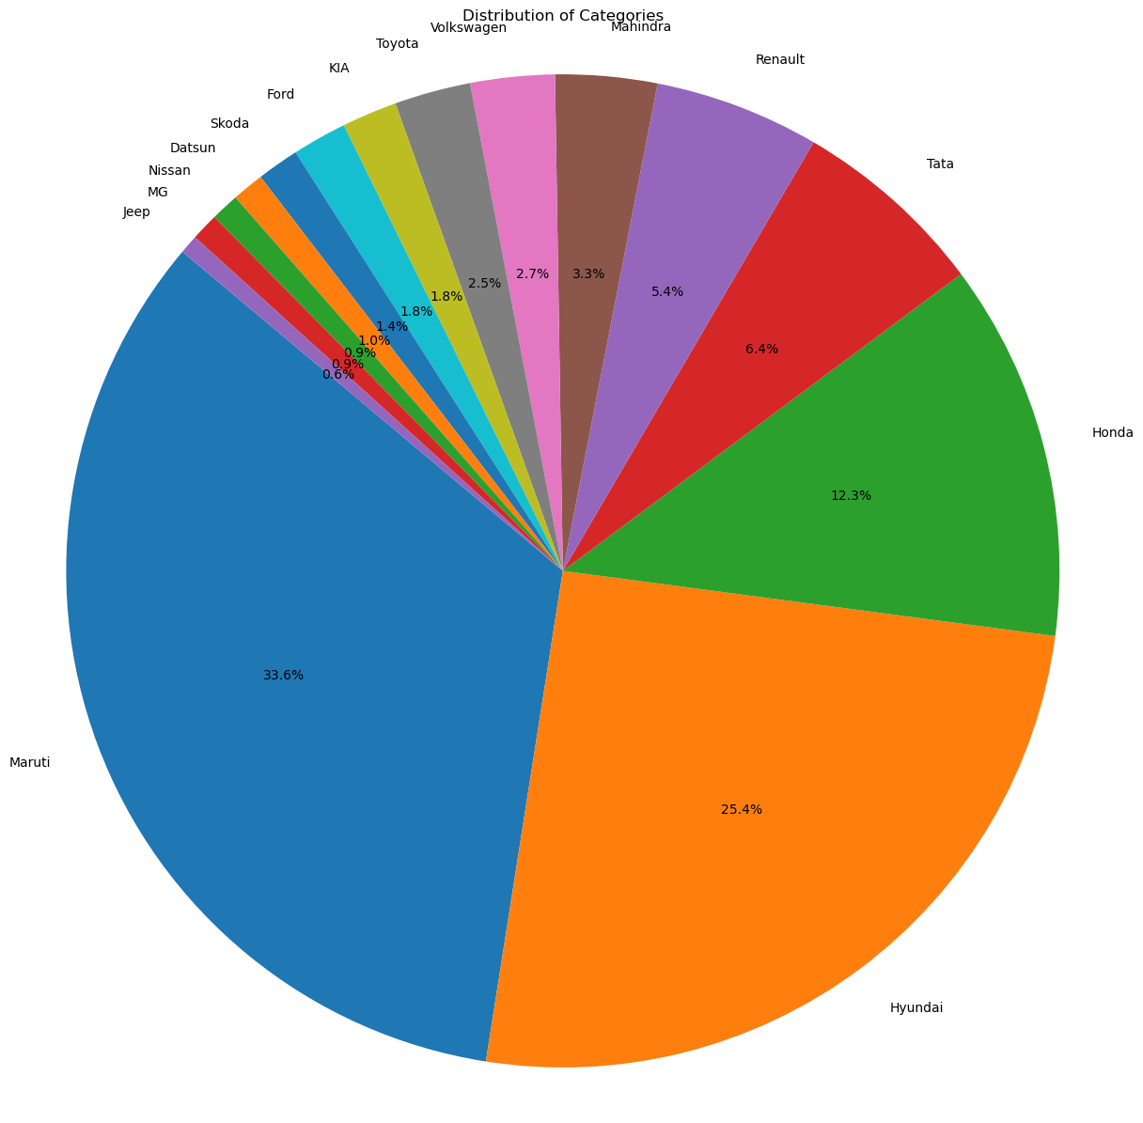
Distribution of Brands in percentages

Slide 14
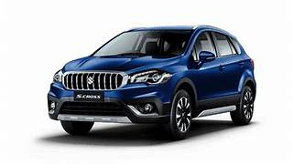
Conclusion
After analyzing the data, the top five car brands in five major cities are as follows:
Maruti Suzuki: Dominates the market in all five cities, showing strong popularity across the board.
Hyundai: Holds a significant market share in most cities, indicating consistent demand.
Honda: Shows moderate popularity, particularly in cities like Delhi and Bangalore.
Tata: Emerges as a prominent choice, especially in cities like Mumbai and Bangalore.
Renault: Also demonstrates noticeable presence, with higher popularity in cities like Mumbai and Delhi.
Overall, Maruti Suzuki emerges as the top choice in all five major cities, followed by Hyundai and other brands like Honda, Tata, and Renault, each showing varying degrees of popularity across different locations.

Slide 15

Special Thanks
Faculty – Ram Sir
Mentor – Bhanu Prakash Sir

